Slide 1
Computer Graphics - Volume Rendering -
Pascal Grittmann, Jaroslav Křivánek
Using pictures from: Monte Carlo Methods for Physically Based Volume Rendering; SIGGRAPH 2018 Course; Jan Novák, Iliyan Georgiev, Johannes Hanika, Jaroslav Křivánek, Wojciech Jarosz

Slide 2
Overview
So far:
Light interactions with surfaces
Assume vacuum in and around objects
This lecture:
Participating media
How to represent volumetric data
How to compute volumetric lighting effects
How to implement a very basic volume renderer

Slide 5
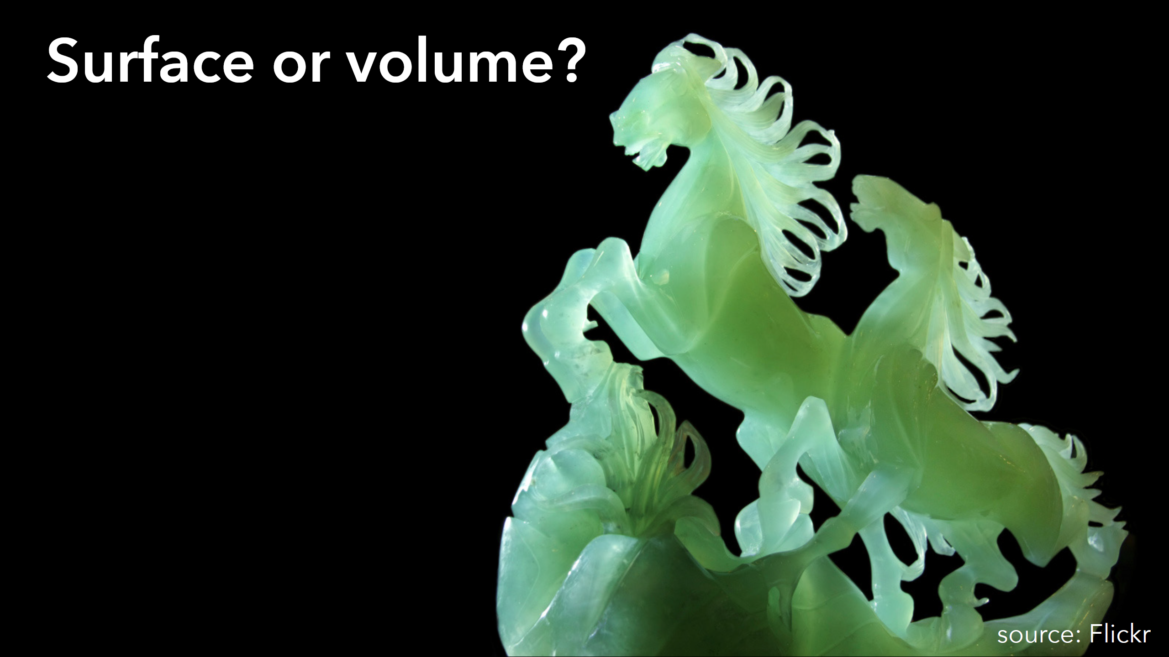

Slide 7
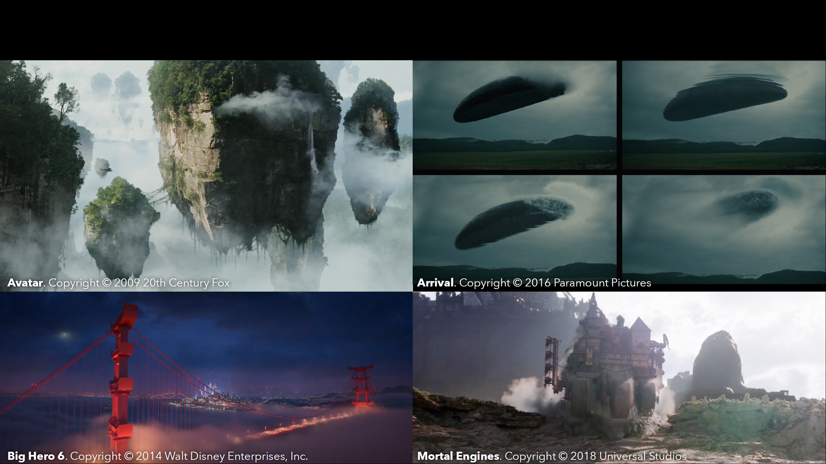

Slide 8
Fundamentals

Slide 9
Volumetric Effects
Light interacts not only with surfaces but everywhere inside!
Volumes scatter, emit, or absorb light
http://coclouds.com
http://wikipedia.org
http://commons.wikimedia.org

Slide 10
Approximation: Model Particle Density
Modeling individual particles of a volume is, of course, not practical
Instead, represent statistically using the average density
(Same idea as, e.g., microfacet BSDFs)

Slide 11
Volume Representation
Many possibilities (particles, voxel octrees, procedural,…)
A common approach: Scene objects can “contain” a volume

Slide 12
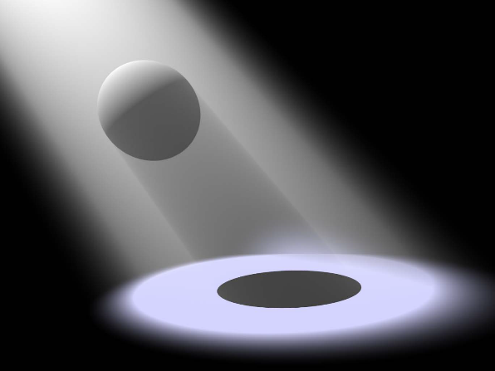
Volume Representation
Homogeneous:
Constant density
Constant absorption, scattering, emission,
Constant phase function (later)
Heterogeneous:
Coefficients and/or phase function vary across the volume
Can be represented using 3D textures
(e.g., voxel grid, procedural)
http://wikipedia.org

Slide 13
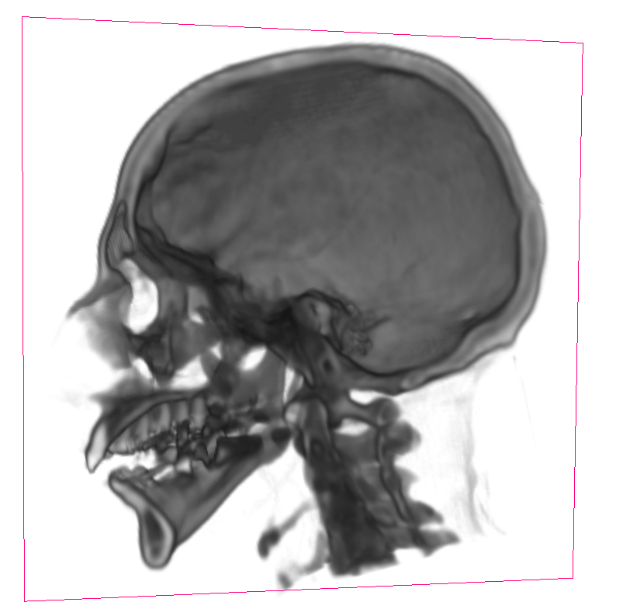
Data Acquisition
Real-world measurements via tomography
Simulation, e.g.,
Fluids,
Fire and smoke,
Fog
https://docs.blender.org

Slide 14
Simulating Volumes
Mathematical Formulation of Volumetric Light Transport

Slide 15
So far: Assume Vacuum
Compute $L_{o}(x,ω_{o})$ using the rendering equation
$$x$$

Slide 16
Volume Absorbs and Scatters Light
Compute $L_{o}(x,ω_{o})$ using the rendering equation
Only a fraction $T\left(a,b\right)L_{o}\left(x,ω_{o}\right)$ arrives at the eye
$$a$$
$$b$$
$$x$$

Slide 17
Volume Emits Light
Compute $L_{o}(x,ω_{o})$ using the rendering equation
Only a fraction $T\left(a,b\right)L_{o}\left(x,ω_{o}\right)$ arrives at the eye
Every point $z$ between $a$ and $b$ might emit light
$$a$$
$$b$$
$$x$$
$$z$$

Slide 18
Volume Scatters Light
Compute $L_{o}(x,ω_{o})$ using the rendering equation
Only a fraction $T\left(a,b\right)L_{o}\left(x,ω_{o}\right)$ arrives at the eye
Every point $z$ between $a$ and $b$ might emit light
Every point $z$ might be illuminated through the volume
$$a$$
$$b$$
$$x$$
$$z$$

Slide 19
Attenuation
$$a$$
$$b$$
$$x$$
$$L_{i}= ?L_{0}\left(x\right)$$
http://commons.wikimedia.org
Computing Absorption and Out-Scattering

Slide 20
Attenuation = Absorption + Out-Scattering
Every point in the volume might absorb light or scatter it in other directions
Modeled by absorption and scattering coefficients: $μ_{a}\left(z\right)$ and $μ_{s}\left(z\right)$ (both in $[m^{−1}])$
Might depend on position, direction, time, wavelength,…
For simplicity: we assume only positional dependence
$$a$$
$$b$$
$$x$$
$$z$$

Slide 21
Computing Absorption – Intuition
Consider a small segment $Δz$
Along that segment, radiance is reduced from $L$ to $L^{′}$
$L^{′}=L−L{(μ}_{a}Δz)$
Where $μ_{a}$ is the percentage of radiance that is absorbed (per unit distance)
$$L^{′}$$
$$L$$
$$a$$
$$Δz$$
$$b$$

Slide 22
Computing Absorption – Intuition
Consider a small segment $Δz$
Along that segment, radiance is reduced from $L$ to $L^{′}$
$L^{′}=L−L{(μ}_{a}Δz)$
Where $μ_{a}$ is the percentage of radiance that is absorbed (per unit distance)
Lets rewrite this:
$ΔL=L^{′}−L=−Lμ_{a}Δz$
$$L^{′}$$
$$L$$
$$a$$
$$Δz$$
$$b$$

Slide 23
Computing Absorption – Exponential Decay
$ΔL=−μ_{a} L Δz$
For infinitely small $Δz$, this becomes
$dL=−μ_{a} L dz$
A differential equation that models exponential decay!
Solution: $L\left(a\right)=L_{o}\left(x\right) e^{−\int_{0}^{z}{μ_{a}\left(t\right) dt}}$
$${L\left(b\right)=L}_{o}\left(x\right)$$
$$L\left(a\right)$$
$$L^{′}$$
$$L$$
$$a$$
$$Δz$$
$$b$$
$$x$$

Slide 24
Computing Out-Scattering
Same as absorption, only different factor!
$L\left(a\right)=L_{o}\left(x\right) e^{−\int_{0}^{z}{μ_{s}\left(t\right) dt}}$
$$a$$
$$b$$
$$x$$
$$z$$

Slide 25
Computing Attenuation
Fraction of light that is either absorbed or out-scattered (per unit distance)
$μ_{t}=μ_{a}+μ_{s}$
Many different names: extinction / attenuation / transport coefficient
$L\left(a\right)=L_{o}\left(x\right) e^{−\int_{0}^{z}{(μ_{a}\left(t\right)+μ_{s}\left(t\right)) dt}}$
Attenuation: $T\left(a,b\right)=e^{−\int_{b}^{a}{μ_{t}\left(t\right) dt}}$
$$a$$
$$b$$
$$x$$
$$z$$

Slide 26
Estimating Attenuation
We need to evaluate another integral:
$T\left(a,b\right)=e^{−\int_{b}^{a}{μ_{t}\left(t\right) dt}}$
Many approaches, e.g., Monte Carlo integration or deterministic quadrature

Slide 27
Estimating Attenuation – Ray Marching
We need to evaluate another integral:
$T\left(a,b\right)=e^{−\int_{b}^{a}{μ_{t}\left(t\right) dt}}$
Many approaches, e.g., Monte Carlo integration or deterministic quadrature
Ray marching: evaluate at discrete positions (fixed stepsize $Δz$)
$\int_{b}^{a}{μ_{t}\left(t\right) dt}≈\sum_{i}{{μ_{t}(z}_{i}+ε) Δz}$
Randomized offset $ε$for each ray to avoid aliasing problems
$$a$$
$$Δz$$
$$Δz$$
$$Δz$$
$$Δz$$
$$b$$
$$x$$
$$z_{1}$$
$$z_{2}$$
$$z_{3}$$

Slide 28
Emission
$$a$$
$$b$$
$$z$$
Explosions!
http://wikipedia.org

Slide 29
Every Point Might Emit Light
Assume $z$ emits $L_{e}\left(z\right)$ towards $a$
Some of that light might be absorbed or out-scattered: It is attenuated
$L\left(a\right)=L_{e}\left(z\right) T\left(z,a\right)$
$$a$$
$$b$$
$$z$$

Slide 30
Every Point Might Emit Light
Assume $z$ emits $L_{e}\left(z\right)$ towards $a$
Some of that light might be absorbed or out-scattered: It is attenuated
$L\left(a\right)=L_{e}\left(z\right) T\left(z,a\right)$
Happens at every point along the ray!
$L\left(a\right)=\int_{a}^{b}{L_{e}\left(z\right) T\left(z,a\right) dz}$
Another integral…
$$a$$
$$b$$
$$z$$

Slide 31
Ray Marching for Emission
Same as before: integrate via quadrature
$\int_{a}^{b}{L_{e}\left(z\right) T\left(z,a\right) dz}≈\sum_{i}{L_{e}\left(z_{i}\right) T\left(z_{i},a\right) Δz}$
Attenuation $T\left(z_{i},a\right)$ estimated as before
$$a$$
$$Δz$$
$$Δz$$
$$Δz$$
$$Δz$$
$$b$$
$$x$$
$$z_{1}$$
$$z_{2}$$
$$z_{3}$$

Slide 32
Ray Marching for Emission
Same as before: integrate via quadrature
$\int_{a}^{b}{L_{e}\left(z\right) T\left(z,a\right) dz}≈\sum_{i}{L_{e}\left(z_{i}\right) T\left(z_{i},a\right) Δz}$
Attenuation $T\left(z_{i},a\right)$ estimated as before
Attenuation can be incrementally updated:
$T\left(z_{i},a\right)=T\left(z_{i−1},a\right) T\left(z_{i},z_{i−1}\right)$
(because it is an exponential function)
$$a$$
$$Δz$$
$$Δz$$
$$Δz$$
$$Δz$$
$$b$$
$$x$$
$$z_{1}$$
$$z_{2}$$
$$z_{3}$$

Slide 33
In-Scattering
$$a$$
$$b$$
$$z$$
Accounting for “Reflections” Inside the Volume

Slide 34
Direct Illumination (Single-scattering)
Account for the (attenuated) direct illumination at every point $z$
Similar to the rendering equation:
$L_{o}\left(z,ω_{o}\right)=\int_{Ω}{L_{i}\left(z, ω_{i}\right) f_{p}\left(ω_{i},ω_{o}\right) dω_{i}}$
Integration over the whole sphere $Ω$
The phase function $f_{p}$ takes on the role of the BSDF
$$a$$
$$ω_{i}$$
$$b$$
$$ω_{o}$$
$$z$$

Slide 35
Phase Functions
$f_{p}\left(ω_{i},ω_{o}\right)$
Describe what fraction of light is reflected from $ω_{i}$ to $ω_{o}$
Similar to BSDF for surface scattering
Simplest example: isotropic phase function
$f_{p}\left(ω_{i},ω_{o}\right)=\frac{1}{4π}$
(energy conservation: $\int_{Ω}{\frac{1}{4π}dω}=1$)

Slide 36
Phase Functions: Henyey-Greenstein
Widely used
Easy to fit to measured data
$f_{p}\left(ω_{i},ω_{o}\right)=\frac{1}{4π}\frac{1−g^{2}}{{\left(1+g^{2}+2g\cos\left(ω_{i},ω_{o}\right)\right)}^{\frac{3}{2}} }$
$g$: asymmetry, mean cosine (scalar)
$\cos\left(ω_{i},ω_{o}\right)$: cosine of angle between the directions

Slide 37
Henyey-Greenstein: Asymmetry Parameter
$g=0$: isotropic
Negative $g$: back scattering
Positive $g$: forward scattering
Back Scattering
Forward Scattering
http://commons.wikimedia.org
http://coclouds.com

Slide 38
How to Estimate Volumetric Direct Illumination
Reflected radiance at a point $z$: $L_{o}\left(z,ω_{o}\right)=\int_{Ω}{L_{i}\left(x, ω_{i}\right) f_{p}\left(ω_{i},ω_{o}\right) dω_{i}}$
In our framework:
Sum over all point lights (as for surfaces)
Trace shadow ray (as for surfaces)
Estimate attenuation along the shadow ray (as for surfaces)
$$a$$
$$ω_{i}$$
$$b$$
$$ω_{o}$$
$$z$$

Slide 39
Ray Marching to Compute In-Scattering
Same as for emission
Goal: estimate the integral $\int_{a}^{b}{T\left(z,a\right) L_{i}\left(z\right){ f}_{p} dz}$
Quadrature:
$\int_{a}^{b}{T\left(z,a\right) L_{i}\left(z\right){ f}_{p} dz}≈\sum_{i}{T\left(z_{i},a\right) L_{i}\left(z_{i}\right) f_{p} Δz}$
$$a$$
$$Δz$$
$$Δz$$
$$Δz$$
$$Δz$$
$$b$$
$$z_{1}$$
$$z_{2}$$
$$z_{3}$$

Slide 40
Ray Marching to Compute In-Scattering
Same as for emission
Goal: estimate the integral $\int_{a}^{b}{T\left(z,a\right) L_{i}\left(z\right){ f}_{p} dz}$
Quadrature:
$\int_{a}^{b}{T\left(z,a\right) L_{i}\left(z\right){ f}_{p} dz}≈\sum_{i}{T\left(z_{i},a\right) L_{i}\left(z_{i}\right) f_{p} Δz}$
Attenuation $T\left(z_{i},a\right)$ estimated as before
Attenuation can be incrementally updated:
$T\left(z_{i},a\right)=T\left(z_{i−1},a\right) T\left(z_{i},z_{i−1}\right)$
(because it is an exponential function)
$$a$$
$$Δz$$
$$Δz$$
$$Δz$$
$$Δz$$
$$b$$
$$z_{1}$$
$$z_{2}$$
$$z_{3}$$

Slide 41
Putting it all Together
A Simple Volume Integrator

Slide 42
A Simple Volume Integrator
Estimate direct illumination at x (as before)
If volume: continue straight ahead until no volume (yields intersections y, z)
$$x$$
$$y$$
$$z$$

Slide 43
A Simple Volume Integrator
Estimate direct illumination at x (as before)
If volume: continue straight ahead until no volume (yields intersections y, z)
Ray marching to estimate attenuation, emission,
$$x$$
$$y$$
$$z$$

Slide 44
A Simple Volume Integrator
Estimate direct illumination at x (as before)
If volume: continue straight ahead until no volume (yields intersections y, z)
Ray marching to estimate attenuation, emission, and in-scattering
Shadow rays to the lights + ray marching to compute attenuation
$$x$$
$$y$$
$$z$$

Slide 45
A Simple Volume Integrator
Estimate direct illumination at x (as before)
If volume: continue straight ahead until no volume (yields intersections y, z)
Ray marching to estimate attenuation, emission, and in-scattering
Shadow rays to the lights + ray marching to compute attenuation
Compute illumination at z (as before)
$$x$$
$$y$$
$$z$$

Slide 46
A Simple Volume Integrator
Estimate direct illumination at x (as before)
If volume: continue straight ahead until no volume (yields intersections y, z)
Ray marching to estimate attenuation, emission, and in-scattering
Shadow rays to the lights + ray marching to compute attenuation
Compute illumination at z (as before)
Add together:
Attenuated illumination from z
Volumetric emission along $\overline{xy}$
In-scattering along $\overline{xy}$
Direct illumination at $x$
$$x$$
$$y$$
$$z$$

Slide 47
A Simple Volume Integrator
Estimate direct illumination at x (as before)
If volume: continue straight ahead until no volume (yields intersections y, z)
Ray marching to estimate attenuation, emission, and in-scattering
Shadow rays to the lights + ray marching to compute attenuation
Compute illumination at z (as before)
Add together:
Attenuated illumination from z
Volumetric emission along $\overline{xy}$
In-scattering along $\overline{xy}$
Direct illumination at $x$
$$x$$
$$y$$
$$z$$

